Slide 1
PowerShell Microservices
At the Service of DevOps
Gael Colas – SynEdgy Limited

Slide 2


Slide 3
42

Slide 4
Agenda
Buzzword!
What‘s wrong with modules?
What‘s a Message Queue?
Rabbitmq with PowerShell
Microservices Architecture
This is not a silver bullet

Slide 5
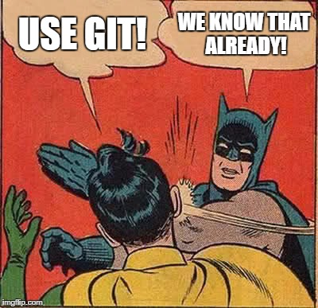
Get-History
Stop clicking around!
Use Git / SCM!
Write Tools not scripts!
Write Tests with Pester!
Have frictionless releases!

Slide 6
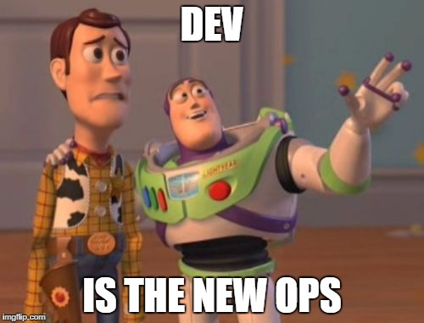
Get-Help about_DevOps
Find Inspiration from the Dev practices

Slide 7
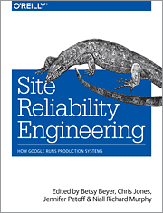
Get-Help SRE
Site Reliability Engineering
Software Engineer focused on:
Reliability
Scalability
Cloud Computing Infra
“SREs develop, maintain and operate software that automates the traditional roles of the system administrator at large scale” WIKIPEDIA

Slide 8

PowerShell Monoliths
„functionally distinguishable aspects are all interwoven, rather than containing architecturally separate components.”
data input and output
data processing
error handling
user interface
I know: Modules and Toolmaking!

Slide 9
What‘s wrong with modules?
Nothing, as long as you:
- Embrace Toolmaking
- Think ‘Unix rule of composition’
- Keep module functionally coherent
Follow low coupling, high cohesion principle
Modularity is the opposite of monolith.

Slide 10
Questions?
The End
Can you create a Monolith if you use modules?

Slide 11
System Thinking!
Are you gluing a monolith out of modules?
How do you consume those modules?
manually via CLI?
within scripts? Other modules?
How do you orchestrate the tasks?
Task/Enterprise scheduler? Orchestrator?
Are you dependant on a (pet) host?
How do you pass data in and out?

Slide 12
Breaking the Silos
To break organisational silos, you also need to break technological silos.
DevOps is broadly a communication and collaboration issue:
Humans need to communicate better
So do your systems
Think about Conway’s law and inverse manoeuvre!

Slide 13
System Communications
How do your systems communicates?
How do you transmit data from one PowerShell process to another?
REST/Http-based API
SMTP
Files on some kind of filesystem
RDBMS / NoSQL
Named Pipe
PSRemoting
Welcome to IPC!

Slide 14
Message Broker & Message Queue

Slide 15

RabbitMQ
Proven Message Broker (10 years anniversary)
Client libs in many languages (C#, Nodes, Py)
Deployable on Azure, AWS , GCE, Docker…
AMQP 0.9.1
PSRabbitMQ, by Chris Duck and Warren Frame.

Slide 16
Demo
PSRabbitMQ

Slide 17
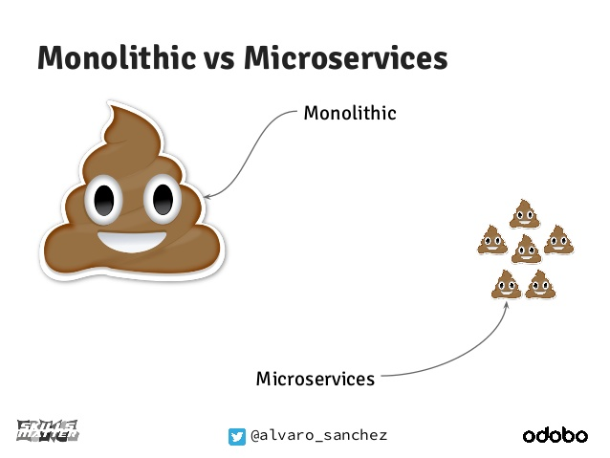
Microservices

Slide 18
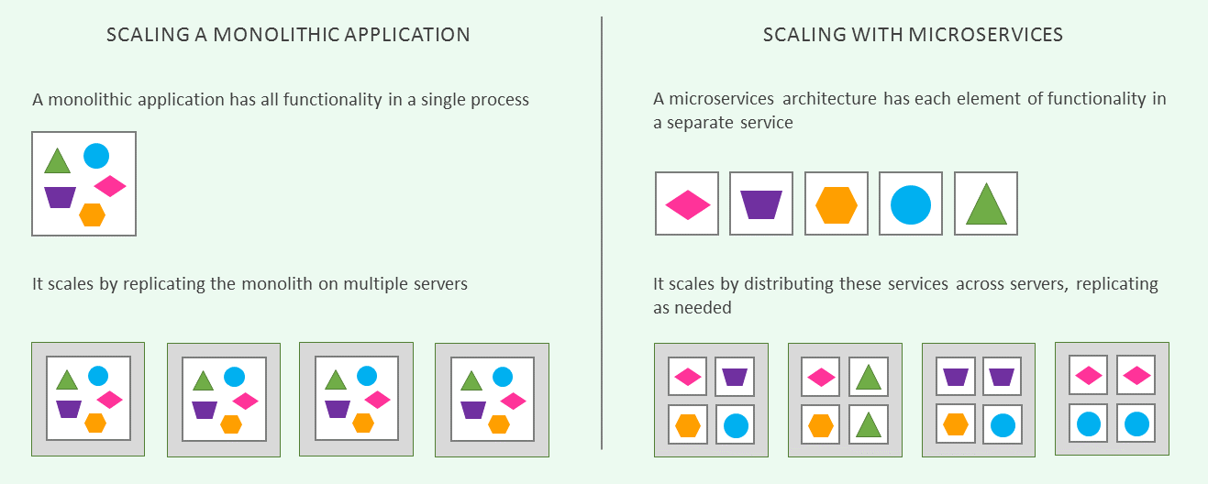
Microservices (continued 1)
Martin Fowler, Microservices
3gamma

Slide 19
Microservices (continued 2)
Conway’s Law: [Article by Sam Newman]
"Any organization that designs a system (defined more broadly here than just information systems) will inevitably produce a design whose structure is a copy of the organization's communication structure.“
Organizational structures impact system design, and system architectures impact organizational structures as well.

Slide 21

What if I told you...
You could:
Communicate between your systems
Execute tasks real-time, on-demand
Load-balance your task execution
Abstract the code behind an API
Create Asynchronous, distributed processes
Improve HA and reliability
Become less dependant of the host
Consume from different techno/platform

Slide 22


Celery
A Proven Python library for Distributed Tasks
Based on distributed message passing
- Protocol to communicate between workers
- JSON serialization
- Supports different brokers, i.e. RabbitMQ, but also Redis, etc…
So… PSCelery

Slide 23
Demo
PSCelery

Slide 24
Not a silver bullet!
Creates new set of challenges:
Persistence
Service Discoverability
Service Monitoring
Oh, but your ‘Devs‘ might be familiar with them!

Slide 25
Summary
Find inspiration from Dev Practices
Use System thinking
To measure the scope of your service
To scope the impact a change can have
Decouple your automation from your infrastructure
Improve system cohesion through communication

Slide 26
Questions?

Slide 27




About_Author
@gaelcolas
Gael Colas Cloud & Windows Automation Consultant
Dev
Ops

Slide 28
Next Steps...
Now: 15 min break
Grab a coffee
Stay here to enjoy next presentation
Change track and switch to another room
Ask me questions or meet me in a breakout session room afterwards

